Slide 1

Tree Operations: Insertion and Deletion
Data Structure | Tree and Heap
Course: Data Structure | Chapter: Tree and Heap | Bachelor of Engineering
DISCOVER · LEARN · EMPOWER
Notes:
Welcome everyone to today's session on Tree Operations. We will focus specifically on how to insert and delete nodes within a tree structure. This is a critical skill for managing dynamic data efficiently in engineering applications.

Slide 2
Course Outcomes
SLIDE 2 / 14
Course Outcome
CO | BT LEVEL | DESCRIPTION
CO1 | BT1 | Understand and apply basic data structures, algorithms, complexity analysis, ADTs, arrays and linked lists.
CO2 | BT2 | Apply and implement stacks and queues in problem-solving.
CO3 | BT3 | Analyse and apply searching, sorting, and hashing techniques.
CO4 | BT4 | Construct and apply tree structures and traversal techniques.
CO5 | BT5 | Represent and solve graph problems using DFS, BFS, and graph algorithms.
Chandigarh University
2 / 14
Notes:
Today's lecture directly supports our Course Outcomes. CO2 helps us understand how tree traversal mimics stack and queue behaviors. CO3 is essential because tree operations form the backbone of efficient searching and sorting algorithms.

Slide 3
Learning Objectives
SLIDE 3 / 14
Learning Outcomes
1
Analyze the step-by-step logic for inserting a new node.
2
Evaluate the three cases required for node deletion.
3
Demonstrate the re-linking process during tree modification.
4
Apply the algorithm to maintain binary search tree properties.
5
Identify common pitfalls in pointer manipulation during deletion.
Chandigarh University
3 / 14
Notes:
By the end of this lecture, you will be able to analyze insertion logic and evaluate deletion cases. We will demonstrate how to re-link nodes correctly. You will also learn to identify common pitfalls that cause memory leaks or broken trees.

Slide 4
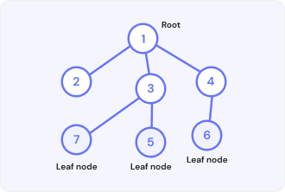
Lecture
SLIDE 4 / 14
Tree Insertion Logic Overview
1
Insertion adds a new node while maintaining tree structure.
2
The algorithm starts by searching for the correct leaf position.
3
New nodes are always added as children of existing leaves.
4
Binary Search Trees require left child for smaller values.
5
Binary Search Trees require right child for larger values.
6
Insertion preserves the height balance in balanced tree variants.
7
Time complexity for insertion is O(h) where h is height.
What is Leaf Node? — Limeup
Chandigarh University
4 / 14
Notes:
Insertion is straightforward: find the spot and attach. For a Binary Search Tree, we compare values to decide left or right. If the tree is empty, the new node becomes the root. Otherwise, we traverse down until we find a null pointer.

Slide 5
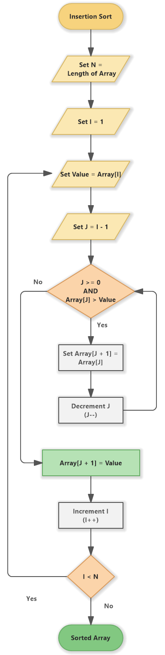
Lecture
SLIDE 5 / 14
Insertion Algorithm Step-by-Step
1
Create a new node with the given data value.
2
If the tree is empty, set the new node as root.
3
Traverse the tree comparing data with current node values.
4
Move left if the new data is smaller than current.
5
Move right if the new data is larger than current.
6
Attach the new node as a left or right child.
7
Update parent pointers to ensure bidirectional connectivity.
Source: www.softwareideas.net
Chandigarh University
5 / 14
Notes:
Let's trace the steps. First, create the node. If the tree is empty, it becomes the root. Otherwise, compare the value. If it is smaller, go left; if larger, go right. Repeat until you find a null spot.

Slide 6
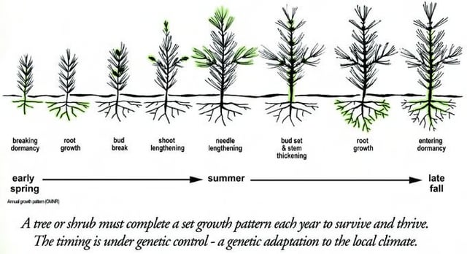
Worked Example
SLIDE 6 / 14
Insertion Process
1
Initial tree has root 50 with children 30 and 70.
2
Insert value 25: Compare 25 with 50, go left to 30.
3
Compare 25 with 30, go left to null position.
4
Attach 25 as the left child of node 30.
5
Insert value 60: Compare 60 with 50, go right to 70.
6
Compare 60 with 70, go left to null position.
7
Attach 60 as the left child of node 70.
Source: external-preview.redd.it
Chandigarh University
6 / 14
Notes:
Consider a tree with root 50. Inserting 25: 25 is less than 50, so go left to 30. 25 is less than 30, so attach it as the left child. Now insert 60: 60 is greater than 50, go right to 70. 60 is less than 70, attach as left child.

Slide 7
Deletion
SLIDE 7 / 14
Case 1 (Leaf Node)
1
A leaf node has no children and is easiest to delete.
2
Simply remove the node from the tree structure.
3
Update the parent's pointer to null for that child.
4
No re-linking of subtrees is required for this case.
5
Memory for the node should be deallocated immediately.
6
The tree structure remains valid after removing a leaf.
7
This operation maintains the Binary Search Tree property.
Chandigarh University
7 / 14
Notes:
Deleting a leaf is the simplest case. You just cut the link from the parent. For example, if you delete node 25 from our previous example, you just set the left pointer of node 30 to null. The rest of the tree remains untouched.

Slide 8
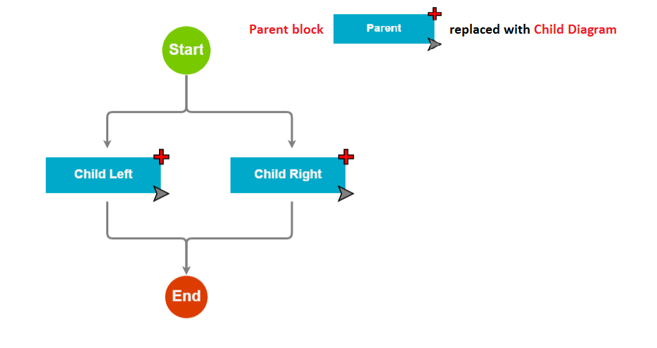
Deletion
SLIDE 8 / 14
Case 2 (One Child)
1
The node to delete has exactly one child.
2
The child must bypass the deleted node to connect to parent.
3
Update the parent's pointer to point to the child.
4
The child's parent pointer must update to the grandparent.
5
This effectively removes the node while preserving the subtree.
6
The tree structure remains connected and valid after deletion.
7
Time complexity remains O(h) for finding the node.
Source: forum.nwoods.com
Chandigarh University
8 / 14
Notes:
When a node has one child, we promote that child. The parent of the deleted node now points to the child. The child's parent pointer updates to the grandparent. This bypasses the deleted node entirely, keeping the tree connected.

Slide 9
Deletion
SLIDE 9 / 14
Case 3 (Two Children)
1
The node to delete has two non-empty subtrees.
2
Direct deletion is impossible without breaking tree structure.
3
Find the inorder successor (smallest value in right subtree).
4
Alternatively, find the inorder predecessor (largest in left subtree).
5
Copy the successor's value into the node to be deleted.
6
Recursively delete the successor node which is now a leaf.
7
This preserves the Binary Search Tree ordering property.
Source: scaler.com
Chandigarh University
9 / 14
Notes:
This is the complex case. You cannot simply remove the node. You find the inorder successor, which is the smallest value in the right subtree. Copy that value into the node you want to delete. Then, delete the successor node, which is now a leaf or has one child.

Slide 10

Worked Example
SLIDE 10 / 14
Deletion with Two Children
FIND INORDER SUCCESSOR
smallest in right subtree (70).
• Delete node 50 which has children 30 and 70.
• Smallest in 70's subtree is 60 (left child of 70).
• Copy value 60 into the node 50 position.
• Now delete the original node 60 from the right subtree.
• Node 60 is a leaf, so simply remove it.
• Tree now has root 60 with children 30 and 70.
Source: www.rifleman.org.uk
Chandigarh University
10 / 14
Notes:
Let's delete root 50. It has two children. The successor is 60. We copy 60 to the root. Now we delete the original 60. Since 60 was a leaf, we just remove it. The tree now has 60 as root, with 30 and 70 as children.

Slide 11
Lecture
SLIDE 11 / 14
Pointer Manipulation Pitfalls
1
Forgetting to update parent pointers causes memory leaks.
2
Incorrectly linking children can create cycles in the tree.
3
Deleting the root without updating the tree root pointer.
4
Accessing null pointers during traversal leads to crashes.
5
Failing to handle the case where successor is the right child.
6
Not freeing memory after logical deletion causes resource waste.
7
Ignoring edge cases like deleting the only node in tree.
Chandigarh University
11 / 14
Notes:
Common errors include forgetting to update parent pointers, which leaves dangling references. Another pitfall is creating cycles if you link a child back to its parent. Always check if the node being deleted is the root, as you must update the root pointer.

Slide 12
Lecture
SLIDE 12 / 14
Complexity Analysis of Operations
1
Insertion time complexity is O(h) where h is tree height.
2
Deletion time complexity is also O(h) for finding node.
3
In a balanced tree, h is log(n) for n nodes.
4
In a skewed tree, h can be n, making it O(n).
5
Space complexity is O(1) for iterative insertion and deletion.
6
Recursive implementations use O(h) stack space for calls.
7
Balanced trees like AVL ensure O(log n) performance.
Chandigarh University
12 / 14
Notes:
The time complexity depends on the height of the tree. In a balanced tree, height is logarithmic, so operations are fast. In a skewed tree, height equals the number of nodes, making operations linear. Always consider tree balance for performance.

Slide 13
Lecture
SLIDE 13 / 14
Key Takeaways
DELETION HAS THREE CASES
leaf, one child, or two children.
• Insertion always adds a new node as a leaf.
• Two-child deletion requires finding the inorder successor.
• Pointer updates are critical to maintain tree integrity.
• Balanced trees ensure O(log n) operation efficiency.
Chandigarh University
13 / 14
Notes:
To summarize: insertion adds nodes as leaves. Deletion handles three cases, with the two-child case being the most complex. Always update pointers carefully. Finally, remember that balanced trees are essential for maintaining efficient O(log n) performance.

Slide 14
Lecture
SLIDE 14 / 14
References
DATA STRUCTURES
A Pseudocode Approach with C — Gilberg, Forouzan
• Data Structures — Lipschutz
• Data Structure Using C — AK Sharma
• C and Data structure — P. S. Deshpandey
Chandigarh University
14 / 14
Notes:
These textbooks provide comprehensive coverage of tree operations and algorithms. I recommend Gilberg and Forouzan for pseudocode approaches. Lipschutz offers excellent problem-solving examples. Sharma and Deshpandey are great for C-specific implementations.

